Slide 1


SPQR-Trees and MAX-CUT Problem
SPQR-trees are powerful data structures in graph theory. They represent graph decomposition into triconnected components. This presentation explores their application in solving the MAX-CUT problem, an NP-hard optimization challenge.
by 峰 喬

Slide 2

Introduction to SPQR-Trees
Definition
SPQR-trees represent graph decomposition into triconnected components.
Components
S-nodes (series), P-nodes (parallel), Q-nodes (edges), and R-nodes (rigid).
Applications
Used for planarity testing, graph drawing, and analyzing graph connectivity.
Structure Analysis
Breaks down complex graphs into simpler components.

Slide 3
Introduction to the MAX-CUT Problem
Definition
Importance
Partitioning graph vertices into two disjoint subsets to maximize edges between them.
Used in network design, statistical physics, and circuit layout.
NP-hard problem, computationally challenging for large graphs.
Various approximation algorithms find near-optimal solutions.

Slide 4
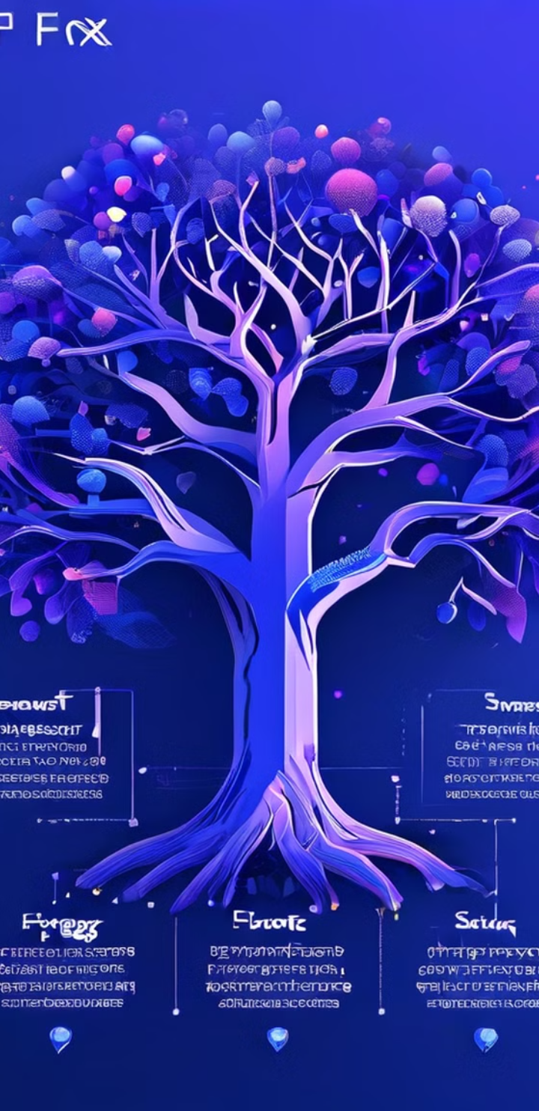
SPQR-Trees in Solving MAX-CUT
1
Graph Decomposition
SPQR-trees decompose graphs into simpler components for individual analysis.
2
Simplification
Reduces problem to smaller, more manageable subproblems.
3
Algorithmic Approaches
Divide and conquer using SPQR-trees to solve MAX-CUT on components.

Slide 5

Challenges and Limitations
1
SPQR-Tree Construction
Complex process, especially for large graphs.
2
Algorithm Integration
Careful consideration needed when integrating with existing MAX-CUT algorithms.
3
Graph Specificity
Effectiveness varies depending on specific graph properties.

Slide 6




Applications and Case Studies
Network Design
Circuit Layout
Research
Optimize network partitioning for efficient designs.
Improve VLSI design by maximizing component separation.
Explore new ways to leverage SPQR-trees in MAX-CUT algorithms.

Slide 7




Future Trends
Algorithmic Improvements
Develop techniques to better integrate SPQR-trees with MAX-CUT algorithms.
Broader Applications
Explore use in bioinformatics and machine learning.
Hybrid Approaches
Combine SPQR-trees with other graph-theoretic approaches for complex optimization.

Slide 8

Conclusion
Advantages
Challenges
Structured graph decomposition
Complex integration
Simplification of MAX-CUT
Graph-specific effectiveness
Valuable for optimization problems
Ongoing research needed

Slide 9
🙋 Q & A

